Slide 1
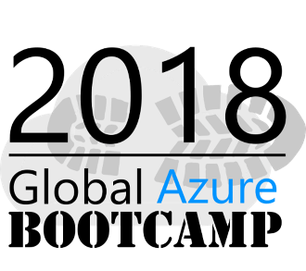
Azure Application Insights and Jupyter Notebook to analyze large scale data

Slide 2
Who am I?
Senior Tech Lead at 99X Technology
MVP – Visual studio and related technologies
Top Contributor on Stack overflow - https://stackoverflow.com/users/1749403/sajeetharan
Opensource Contributor -
https://github.com/sajeetharan
Angular Enthusiast -
https://stackblitz.com/@sajeetharan
Tweet me @kokkisajee

Slide 3


Why Logging is important ?

Slide 4
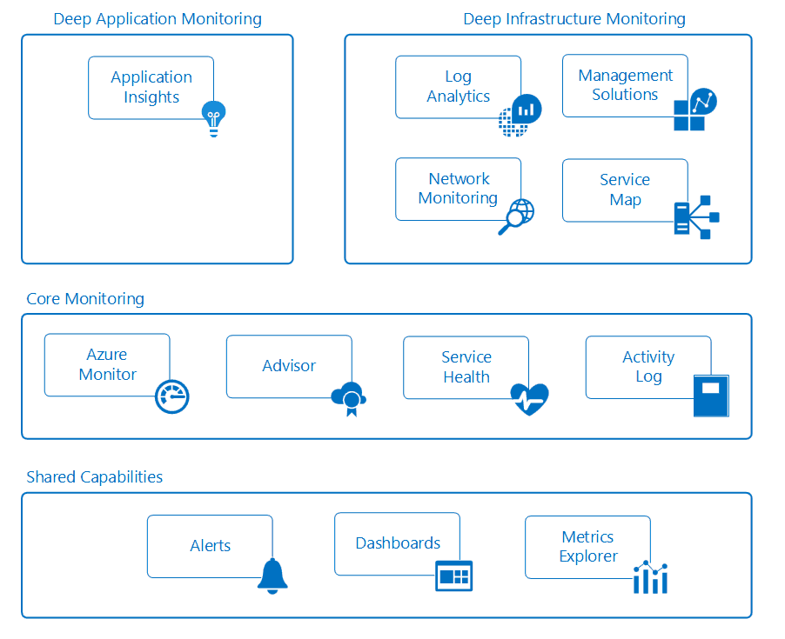

Slide 5
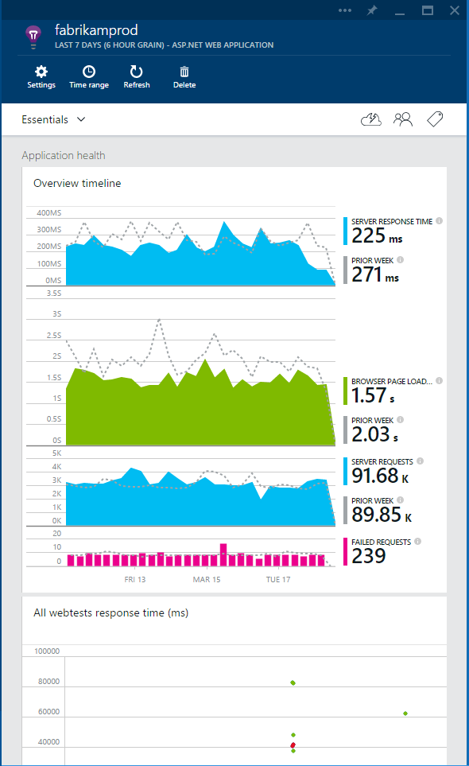
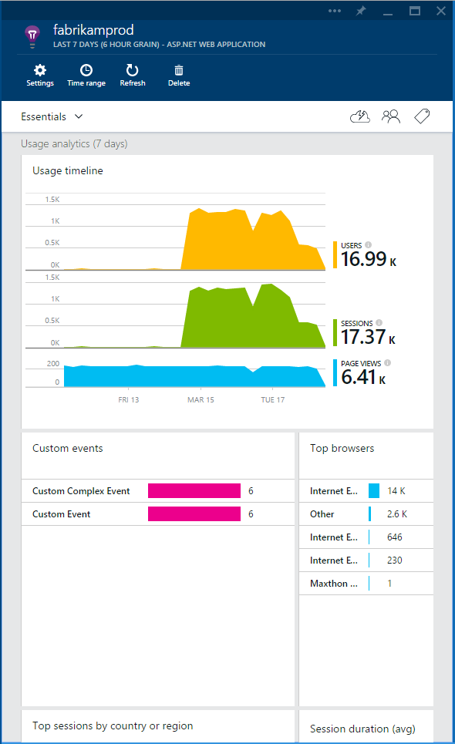
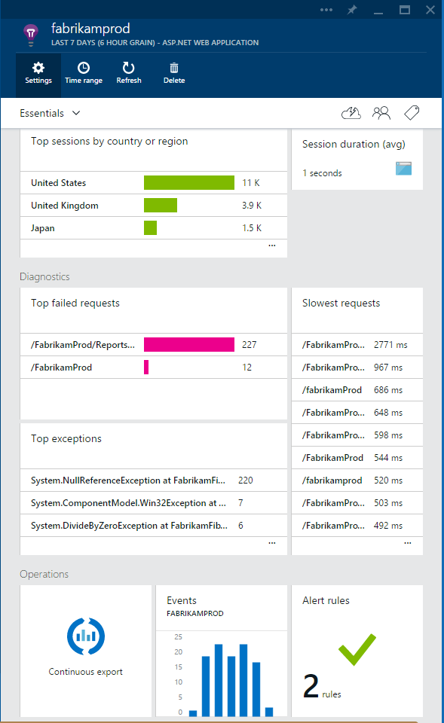


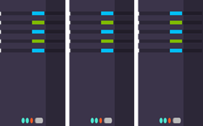
What is Application Insights?
3
Get a 360° view of the application including availability, performance and usage patterns
1
Telemetry is collected at each tier: mobile applications, server applications and browser
2
Telemetry arrives in the Application Insights service in the cloud where it is processed & stored

Slide 6




Sources of Telemetry
1
Outside-in monitoring
URL pings and web tests from 16 global points of presence
2
Observed user behavior
How is the application being used?
3
Developer traces and events
app
Whatever the developer would like to send to Application Insights
4
Observed application behavior
platform
No coding required – service dependencies, queries, response time, exceptions, logs, etc.
infrastructure
Infrastructure performance
5
System performance counters

Slide 7









Key capabilities
Any app support
Easily add analytics across multiple platforms including: ASP.NET, Java/J2EE, iOS, Android, Windows, as well as OSS technologies such as Node.JS, PHP, Ruby, Python, etc.
Open source SDK: https://github.com/Microsoft/ApplicationInsights-Home
Logging framework: Log4Net, nLog, System.Diagnostics Log4J, Logback

Slide 8
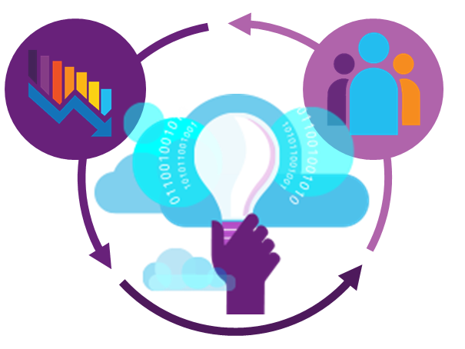
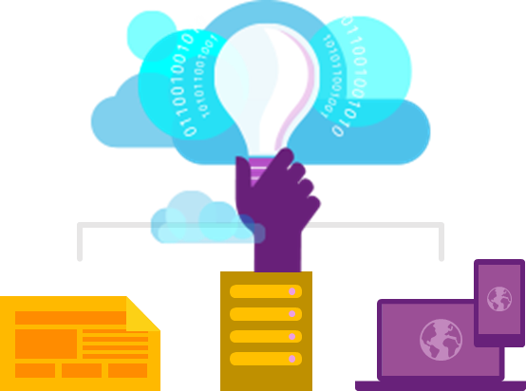
Key capabilities
360° View Across
Availability, Performance & Usage
Overall app health via Overview Blade
Quickly correlate performance & usage data
Detailed insights with a click of a button through intuitive data exploration
Fast & Powerful Diagnostics & Usage Insights
Quickly diagnose availability & performance issues
Learn & improve continuously with usage insights
Extend your telemetry data
Export your data for further analysis
Built-in Analytics
for any app
Supports any app type
Zero-click enablement
No-touch monitoring

Slide 9
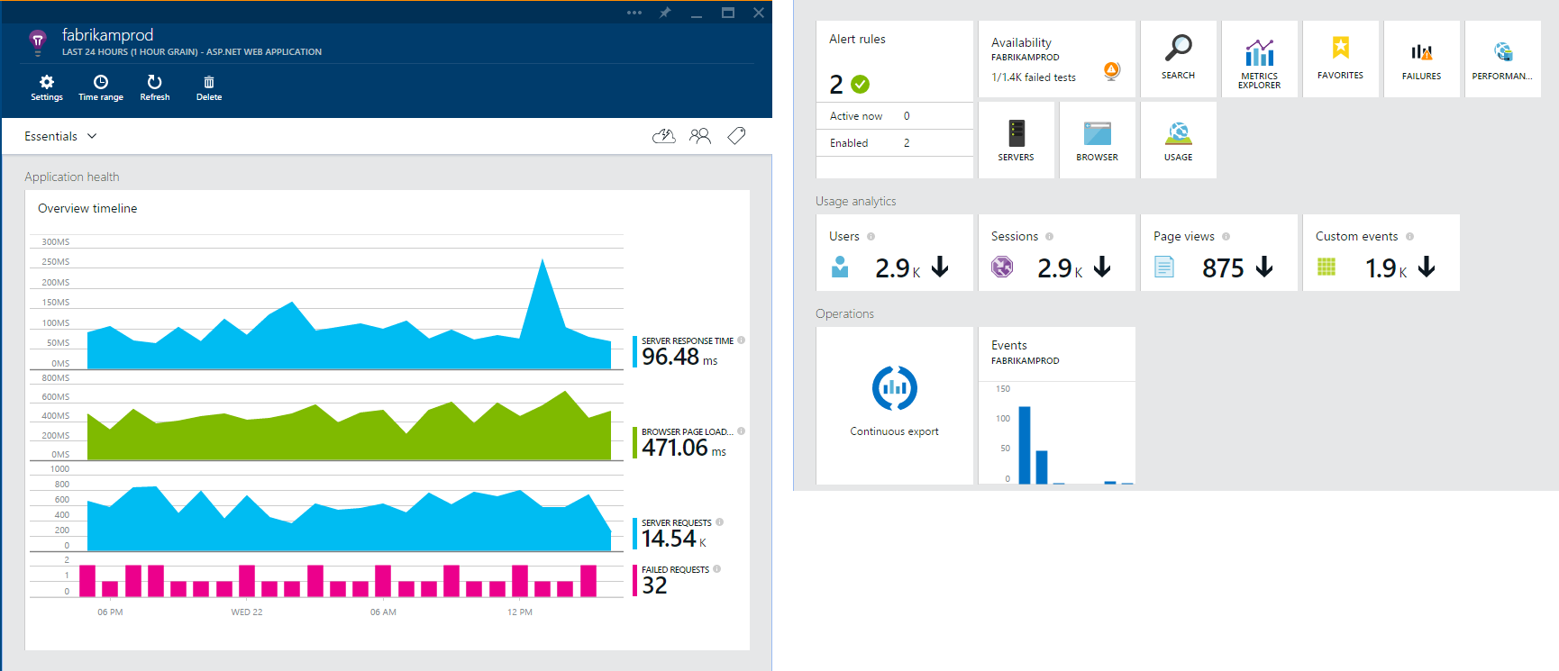
Overview Blade
Out of the box experience
Provides a summary of the application’s health - availability, performance and usage
Paired timeline allows users to quickly correlate metrics and identify trends

Slide 10
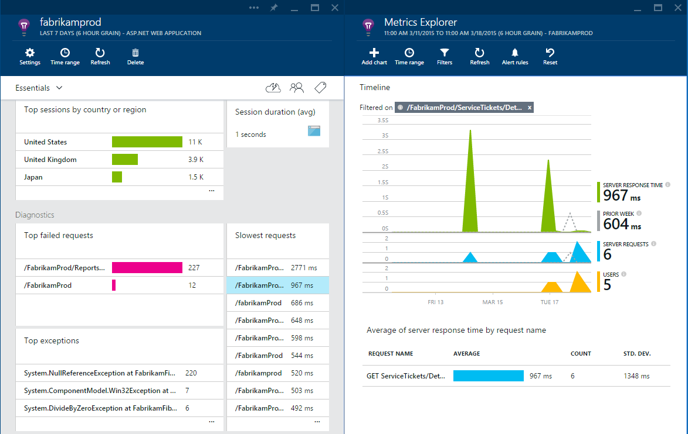
Drill down
Detailed insights with the click of a button
Correlate performance and usage in a single view
Pinpoint problems and investigate questions like “Do I have network performance issues that hurt user adoption?”
Click on specific metric and drill into detailed information and answer questions such as “what request is failing the most?”

Slide 11
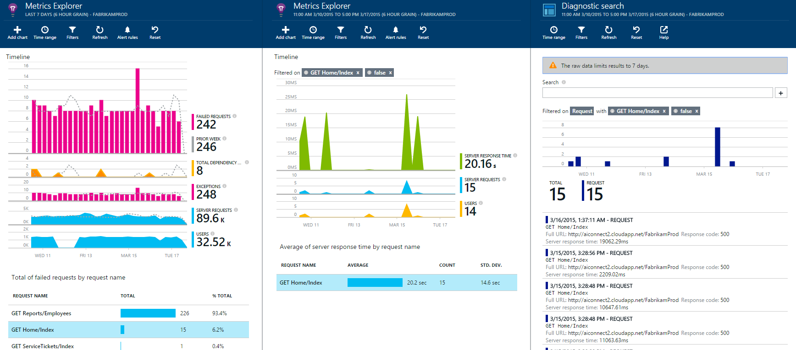
Drill down tools
Powerful insights with Metrics Explorer and Diagnostic Search
Metrics Explorer provides a flexible multi-dimensional UI over custom and out-of-the-box telemetry collected
Diagnostic Search enables efficient search over large sets of data using the query experience

Slide 12
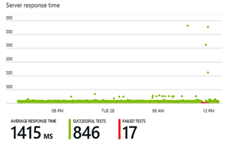
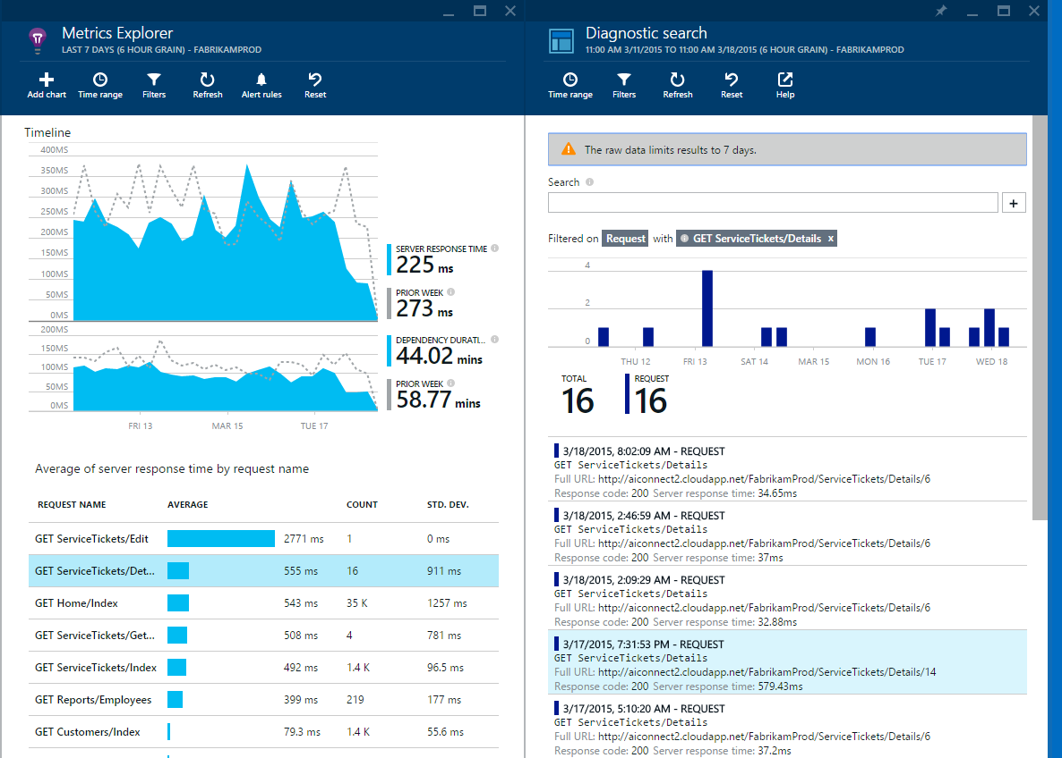
Fast and powerful insights
Identify & triage availability issues
Monitor your web sites with simple pings to complex web tests from points around the world
Diagnose & solve performance problems
Quickly diagnose issues by accessing rich application performance data from the client view to dependencies
Mobile crash/sever exception analytics
Real time view of crashes happening on devices, allowing you to focus on fixing key issues with the biggest impact first

Slide 13
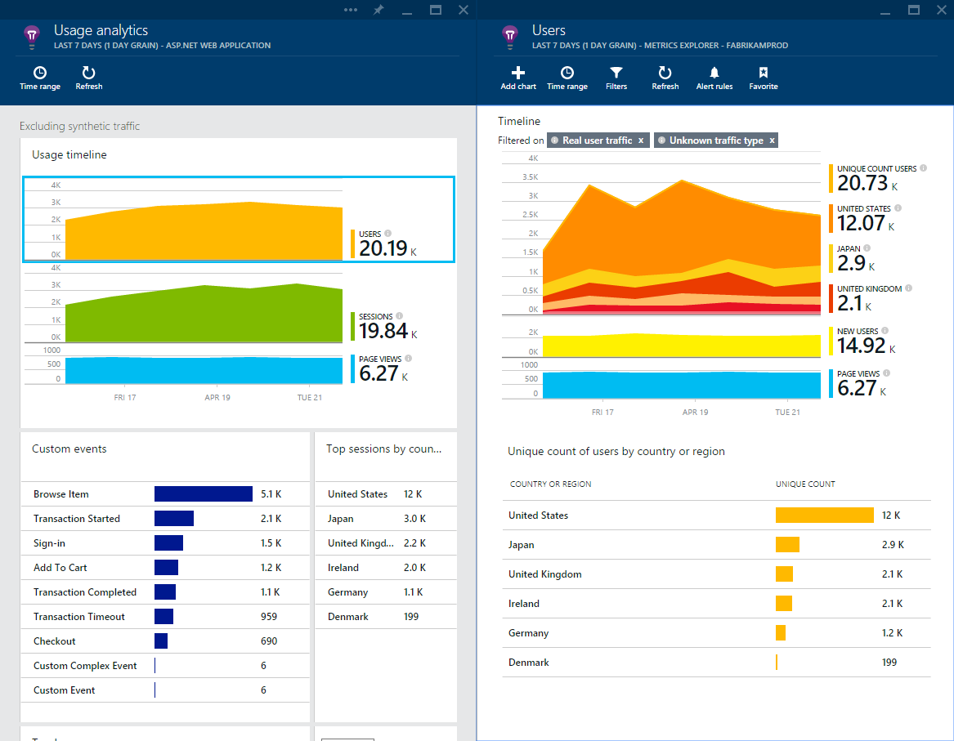
Fast and powerful insights
Learn & improve with usage insights
Understand where your users are coming from and where they spend most of their time
Prioritize future investments and continuously improve your app based on user activity and usage patterns and trends

Slide 14
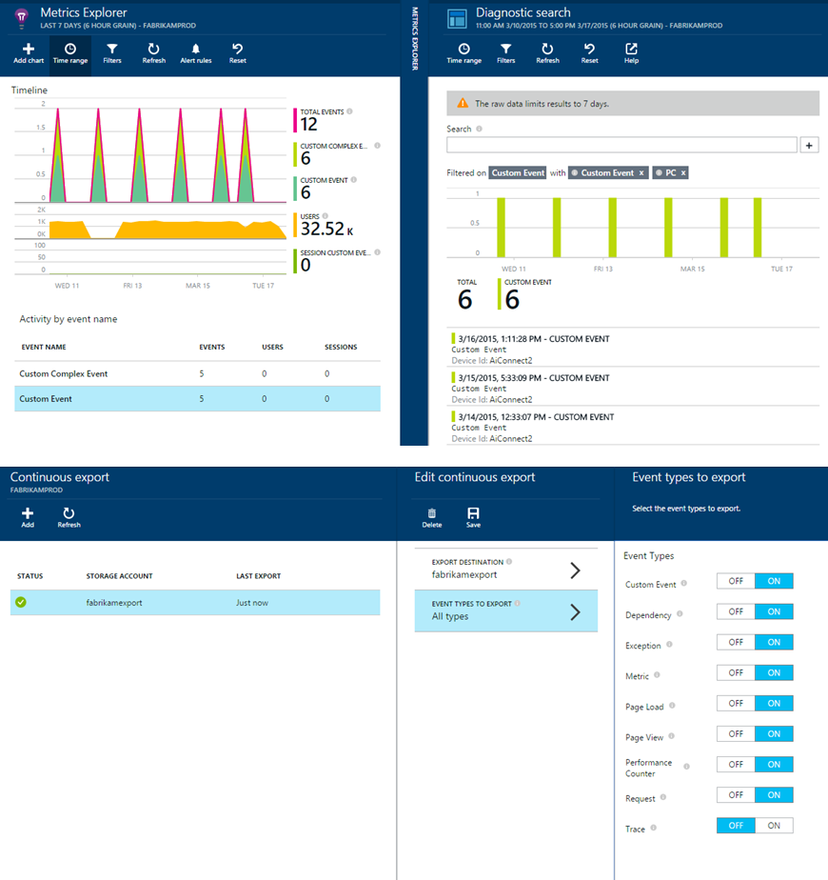
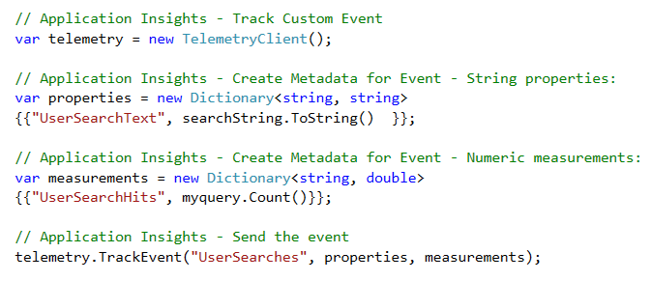
Fast and powerful insights
Extend telemetry data
Add custom metrics and events to better track and analyze user activity
Continuously Export data to Azure Blob Storage for custom integration with other data sources and further analysis

Slide 15
What is Jupyter Notebook
“Open source web application to create and share documents that contain live code, equations, visualizations and explanatory text."
1
Language of choice
Edit and run notebooks via a web browser
2
Big data integration
The kernels and a dashboard

Slide 16

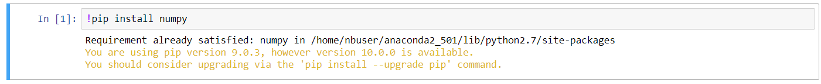
Here comes Azure Notebook
3
Great for sharing and collaborative work
1
Great memo pad - Write code like a sticky note
2
Execute in units of cells

Slide 17
Let’s code
Add Azure Application Insights to your ASP.NET Core web application
Dive into azure notebook with data analysis
AppInsights with azure notebook saves the day

Slide 18
Continue from here….

Slide 19
Q/A

